Slide 1
Lesson 8-Functions/Methods
Functions really increase the functionality of your program
Ben Schwarz

Slide 2
Introduction
Functions let you group code together, so that it forms one single function.
Functions mean that you don't have to repeat the same block of code multiple times.
Let you increase the complexity of your program
In java they are also known as methods and you can use either terminology though for terminology in this lesson we will use method.

Slide 3
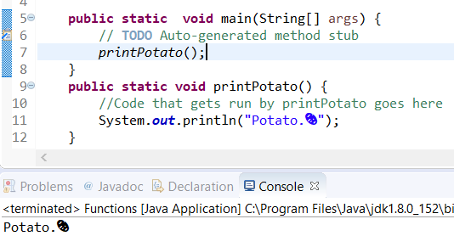
Method Declaration
A method declaration is the code that creates a method. And provides the instructions for what a method would do if it was called. It has two parts, the method header and the method body.
Lets break down the method header first.
Public – this is a access modifier. We will explain these later but public simply means any code in your program can access it.
Static -this won't make sense until you learn OOP, but it means that the function belongs to the class and not an instance of the class. It'll be re-covered in OOP.
``void`` means this function doesn't return a value. This will be covered after the method body.
In the brackets is where variables go. (Explained in a couple slides)

Slide 4
Method Body
This is the part surrounded by curly braces. This is where the code for what a method or function does.

Slide 5
Method Call
This is where you call the method.
Any required variables are inserted into the brackets.
Back to the method header – you don’t need all those keywords. You only really need the void. However…
The main function (which is a special function that gets run when the program starts) is static, it only likes to directly call other static functions. If there wasn't the "static", it would only be happy calling that function if it was calling it from an object... which will be covered more in Object Oriented Programming (OOP).

Slide 6

Variables
One very useful feature of functions is that they can receive and return variables. So your function can take some variables, do something with it, and then give it back to the code that called it.
The following example is something I wrote for ftc (which is why the colours may appear different as it uses Android Studio (intellij):
Method Call
Method Declaration (different part of the code.)

Slide 7
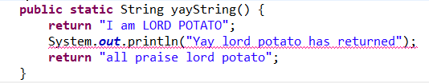
Returning and More Explanation
So, an explanation! When defining a variable, inside the brackets you can define variables to receive information when that function is called.
Every VariableType variableName pair is separated by a coma, and when the function is run, that variable is set to value of whatever was passed into it.
The void bit doesn't actually have to be void. It defines what the function will return. If it is void, it says the function won't return anything. BUT it could be any type of variable.
The return keyword ends the running of the function and returns the value that comes after it back to whatever called the function.
Look at the following method and identify the problem (if viewing from home click the PowerPoint when you want to see the answer):
Answer: The last two lines are never reached since
The function stops running after the first line as it is
A return statement.

Slide 8
Activities
For all you python lovers, write a function which prints to the console. To call the method I would type: print(thing I want to print);
Write a function that finds the average of 4 numbers. Use the function to print out the results (NOTE: The function should NOT print out the result.)
Write a function that returns a boolean, checking if the given number is prime.
Extension: Write a function that flips a coin and returns if it lands heads as a Boolean. You should use java.util.Random to generate result. (You may need to read documentation or google it to find out how. The function should not print it but return the Boolean which you can then use to print)

